Slide 1




Aerodynamics Team:
The 1’s and 0’s of Eagle Space Flight Team
Carl Leake
leakec@my.erau.edu
Mentor: Dr. Julio Benavides

Slide 2
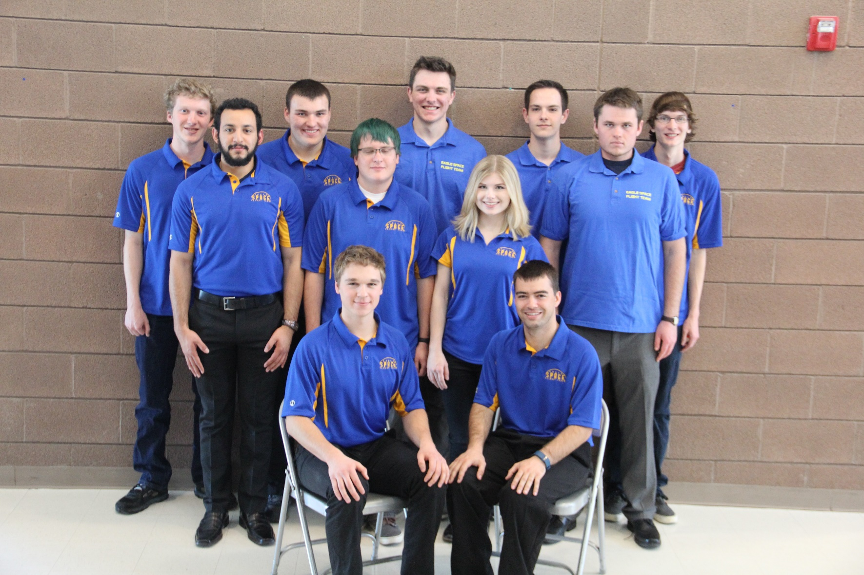
Aerodynamics Team

Slide 3
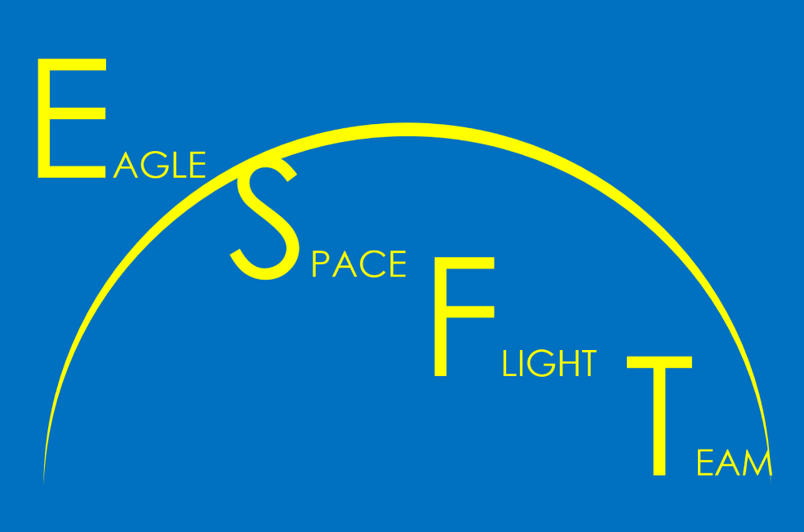
Outline
Team Goals
Previous Projects
Current Projects
Future Development

Slide 4
Team Goals
Develop the shape of SpaceShotOne
Simulate SpaceShotOne’s flight accurately
Keep SpaceShotOne stable during flight
Choose parachute sizes that will recover SpaceShotOne safely
Develop a thermal profile for SpaceShotOne during its flight

Slide 5
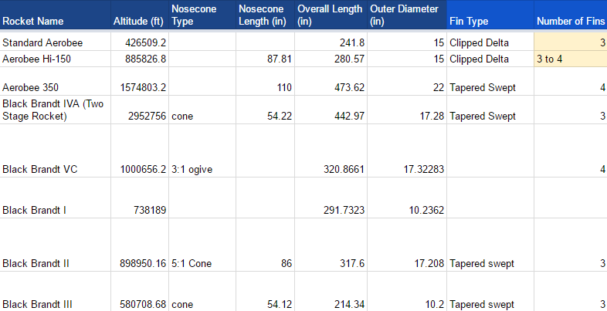
Previous Projects: Non-Dimensionalized Parameters

Slide 6
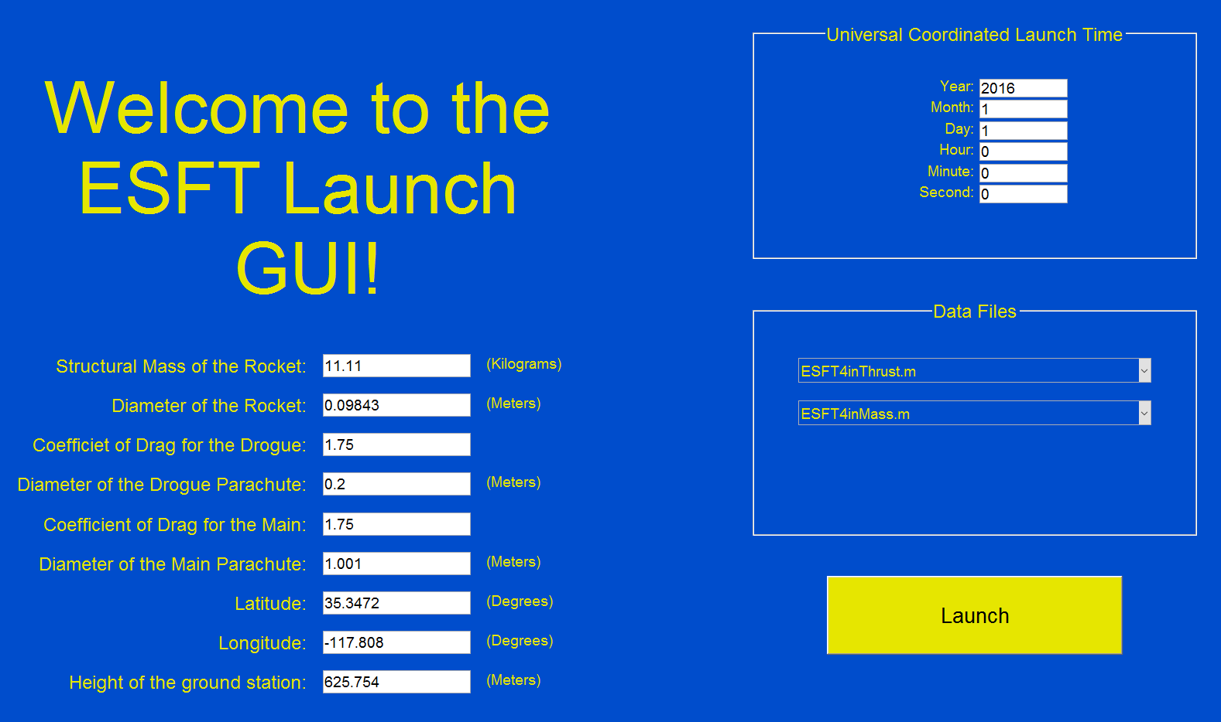
Previous Projects: Translation Simulation

Slide 7
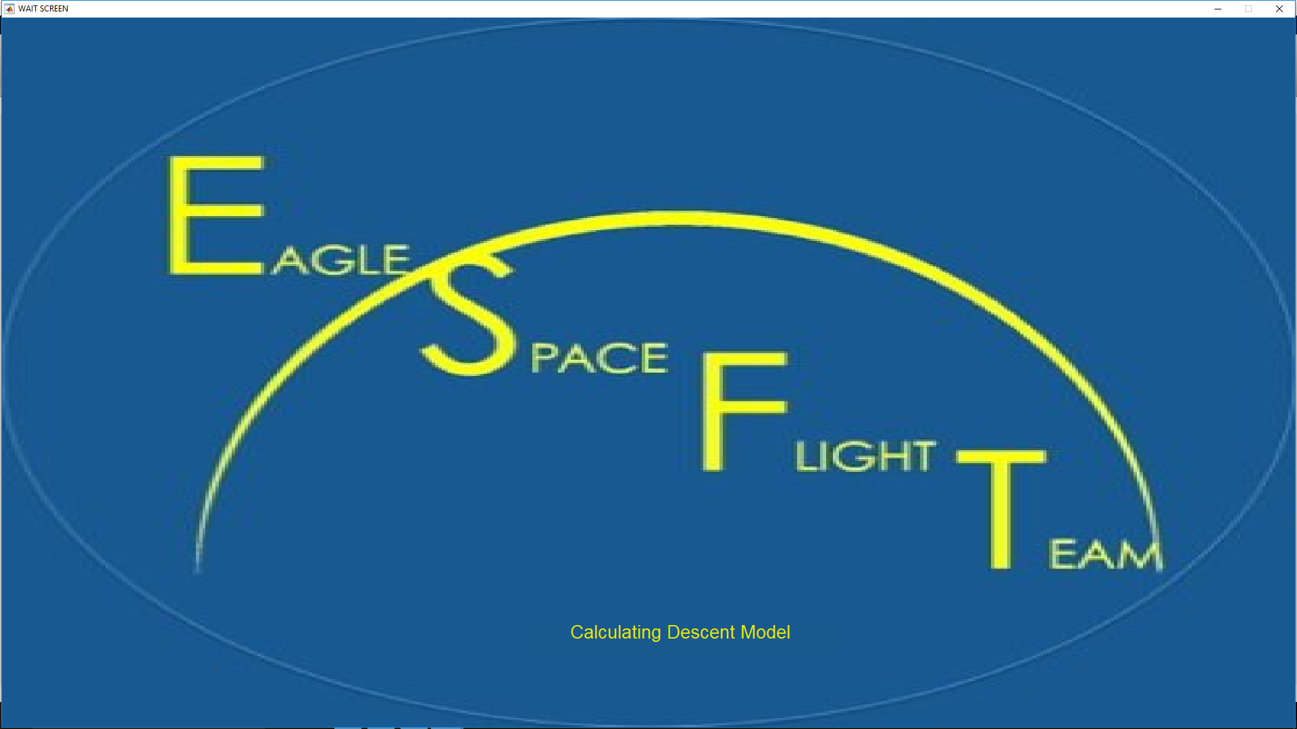
Previous Projects: Translation Simulation

Slide 8
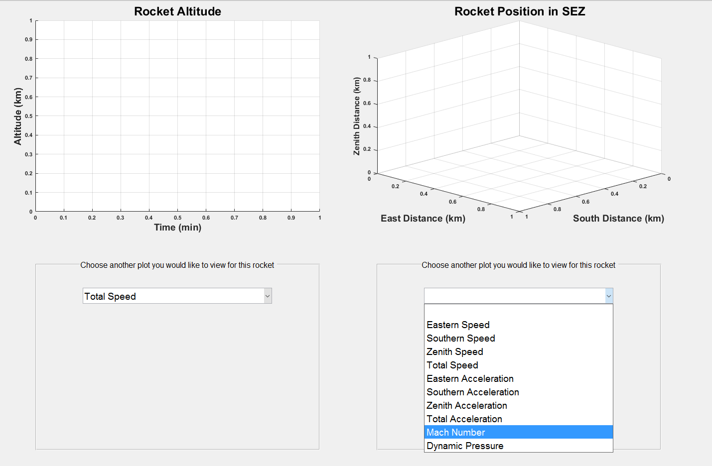
Previous Projects: Translation Simulation

Slide 9
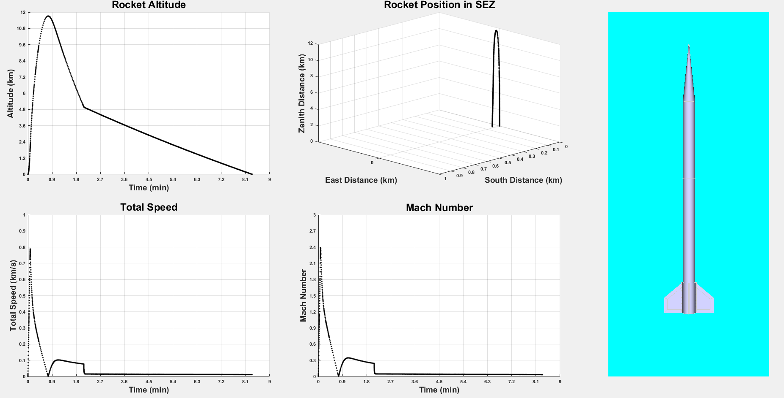
Previous Projects: Translation Simulation

Slide 10
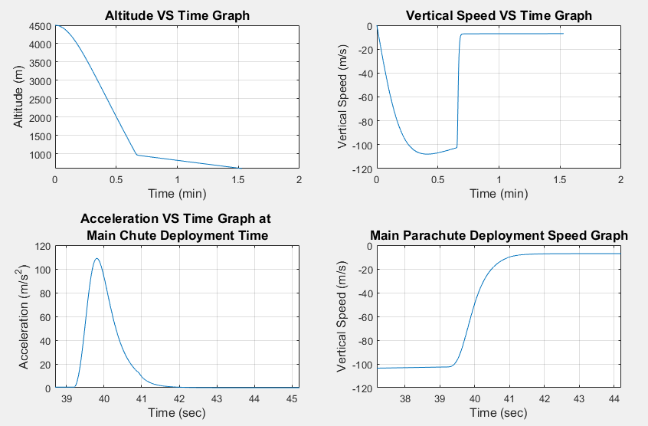
Previous Projects: SuperChute

Slide 11
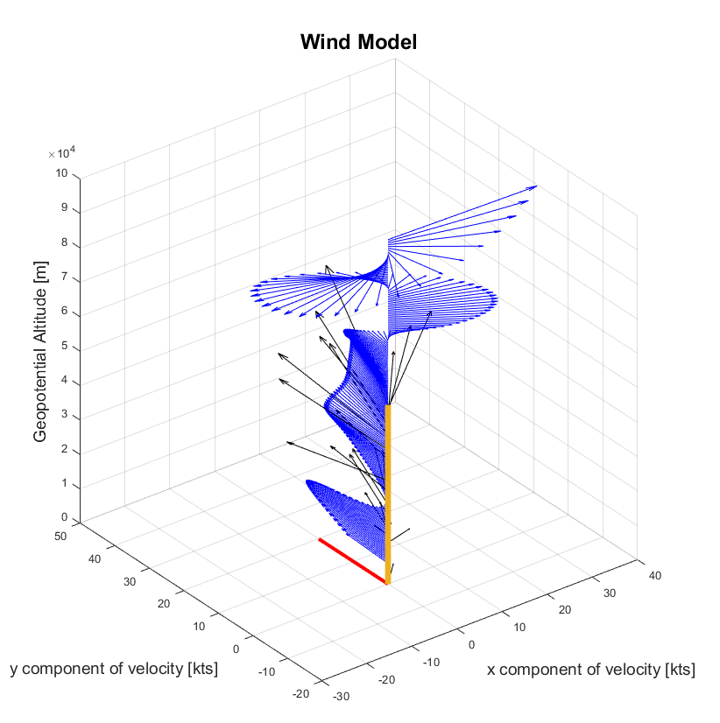
Current Projects: Horizontal Wind Model

Slide 12
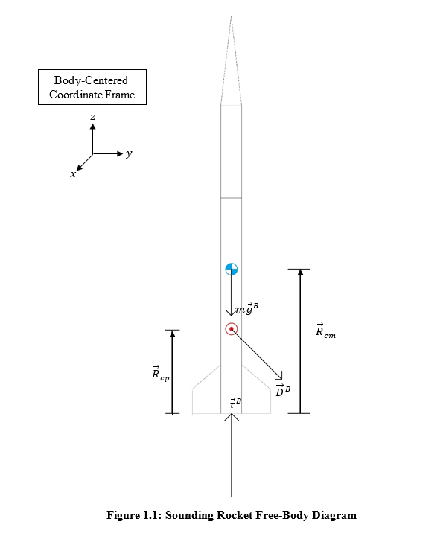
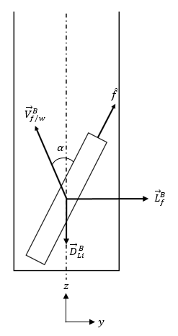
Current Projects: Attitude Model

Slide 13
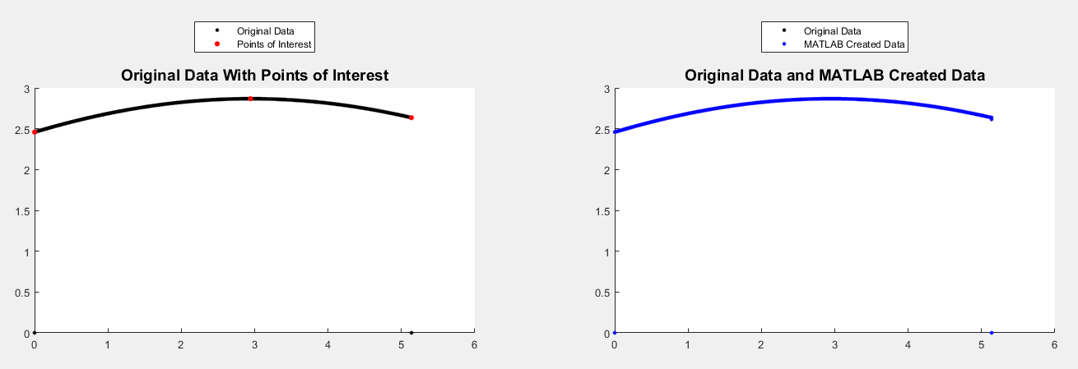
Current Projects: Rocket Properties File Generator

Slide 14
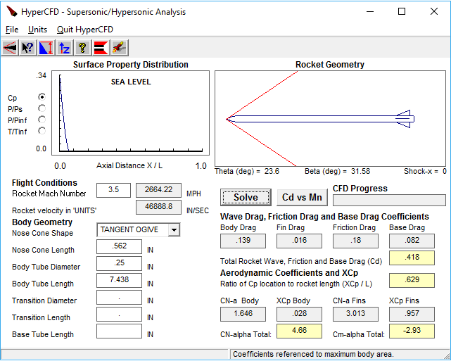
Current Projects: HyperCFD

Slide 15
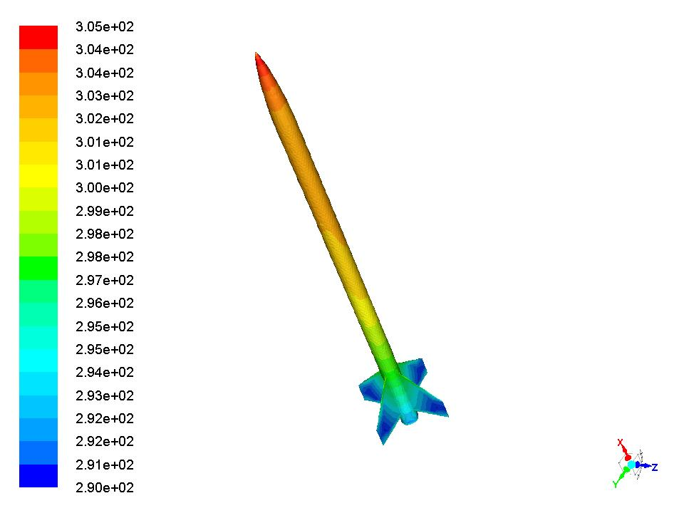
Current Projects: ANSYS Fluent

Slide 16
Future Projects
Integrate HyperCFD data with the attitude model
Verify ANSYS Fluent simulation using hand calculations and experimental data
Compute accuracy of 6 DOF simulation using experimental data
Design iterations with other teams to complete a working design for SpaceShotOne

Slide 17
Acknowledgements
Dr. Gary Yale – ERAU Space Grant Coordinator
Dr. Julio Benavides – Project Mentor
Dr. Wallace Morris
Dr. Brenda Haven

Slide 18

Questions?
Please read more about and contact us at:
www.EagleSpaceFlightTeam.com
www.facebook.com/eaglespaceft/
EagleSpaceFlightTeam@gmail.com

